Slide 1

PRESENTATION OF THE LER WORK OF THE RUMA MUNICIPALITY DEPARTMENT
IDEAS for today and tomorrow

Slide 2

Activities of the Department for Local Economic Development
Planning, organizing, monitoring, and undertaking local economic development activities, cooperating with the Mayor, Project Supervisor, and other administrative services in the municipality
Maintaining database
Supporting the private sector and coordinating public-private dialog
Attracting domestic and foreign investments
Overseeing external financial resources, setting up and allocating project budgeting from various funds including EU, Republic, and others
Engaging in other activities to improve living conditions, work, and business.

Slide 3
Implemented projects in the past period
Projects implemented in the past period have been of great importance for local economic development.
"Building a public lighting system at the Ruma traffic loop (Rumska petlja)" - The Administration for Capital Investment of AP Vojvodina 2018.
“Repairing a road-section in Budjanovci, Municipality of Ruma 2017-2018.
"Reconstruction of the Main Street (Glavna ulica) at the point from the October 27 street to the Zmaj Jovina street in Ruma" – The Capital Investment Administration of AP Vojvodina 2018.
"Reconstruction, adaptation, and restoration of the Gerontological Center (OAP - Old Age Pensioner Center) in Ruma" – The Office for Administration of Public Investment Republic of Serbia 2019.
“Detailed regulation plan "M Block 4-15-1 in the work zone" in Ruma - Provincial Secretary for Urbanism and Environmental Protection (2019).
"Arrangement of road infrastructure in the settlement of Ruma in the streets Sremska and Miloša Crnjanski" - Capital Investment Administration (2019).

Slide 4
Implemented projects in the past period
“Continuation of the initiated consolidation procedures in K.O. Voganj ”- Provincial Secretary for Agriculture, Water Management and Forestry (2019)
“Construction of a gas boiler room for the settlement of Tivol” - Municipality of Ruma (2020)
“Construction of a gas boiler room for the settlement Solidarnost” - Municipality of Ruma (2020)
"Regulation of the canal network in the function of drainage of agricultural land for year 2022 in the municipality of Ruma" - Provincial Secretary for agriculture, water management and forestry
“Rehabilitation of rural roads on the territory of the municipality of Ruma" - Provincial Secretary for Agriculture, Water Management and Forestry (2022)
"Construction of drinking water storage tank V = 570m3 at the location Borkovac in Ruma" – Provincial Secretary for Agriculture, Water Management and Forestry (2020)
“Reconstruction and extension of Streets 15th May and 15th August in Ruma” – Administration for Capital Investment of AP Vojvodina (2020/2021)
“Project of afforestation and improvement of the existing state of the Forest - park Borkovac”- Ministry of Environmental Protection (2022)

Slide 5
Implemented projects in the past period
“ Construction of production and distribution system of district heating Center-South” Ministry of Environmental Protection (2022)
" Rehabilitation and removal of waste from wild landfills in populated areas Kraljevci and Dobrinci”(2022)
“Energy rehabilitation program”- Ministry of Mining and Energy (2022)

Slide 6


EU Projects
The project “H20 WR Town Networking and Engaging Citizens in the Water Resources Protection in Europe”, funded by the Europe for Citizens program, the Network of Cities measure. The municipality of Ruma was the project leader, cooperating with the Ruma Tourist Organization, the Croat town Našice, the Bulgarian municipality Razlog, the Czech municipality Prague 9, the Hungarian municipality Szeged, and the Slovenian municipality Litija. The project duration is 18 months, from 2016-2018.
The project HORIS „Horse route Srem“ funded by the cross-border cooperation program Interreg IPA CBC between Croatia and Serbia. The project duration is 24 months, from 2017-2019. The project was completed the horse barn and indoor and outdoor facilities for equestrian sports. Aside from sports, the project contributes to the equine therapy for healing children and adults. During the project realization, the Srem and Vukovarsko touristic potential strategy was developed.
The Project “The Integrated Approach to Public Property Management in Stara Pazova and Ruma Municipalities” within the EXCHANGE 5 Program 2019-2020, duration 18 months. The project contributes to improving organizational structure, collecting and analyzing public property data, determining property values, establishing public property software, transferring data to the central RDI database, and developing the Invest Study property portfolio.

Slide 7
EU Projects
- Project P.R.I.D.E. Policies for Roma Inclusive Dimension in Europe (2019 - 2021, 24 months) from the Erasmus + program. The goal of the project is the inclusion of Roma people, improving the position of the Roma population, especially young Roma teenagers in the education segment. Workshops, trainings and meetings with teams of teachers, mediators and trainers on the mentioned topic were realized. The Municipality of Ruma and the Youth Style Association are representatives of partners from Serbia, the project coordinator is Romania, and other partner countries are Italy, Greece and Turkey.

Slide 8
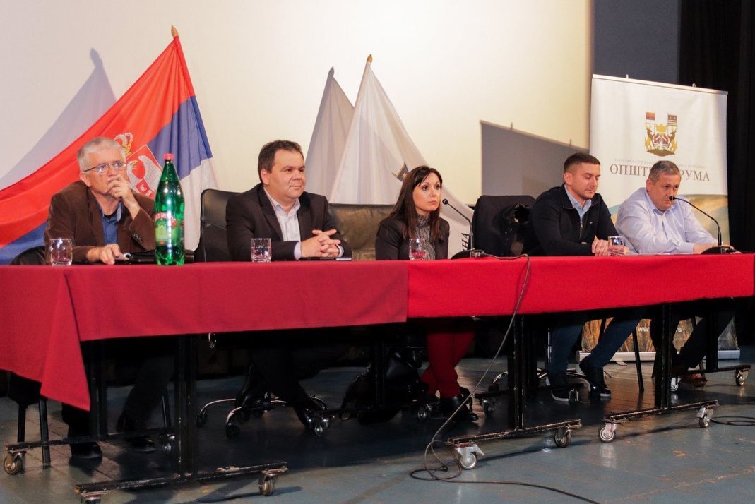
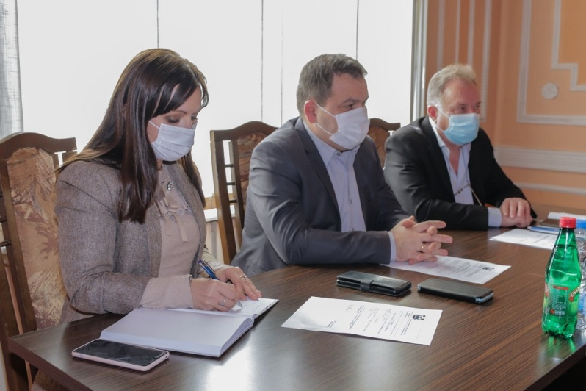
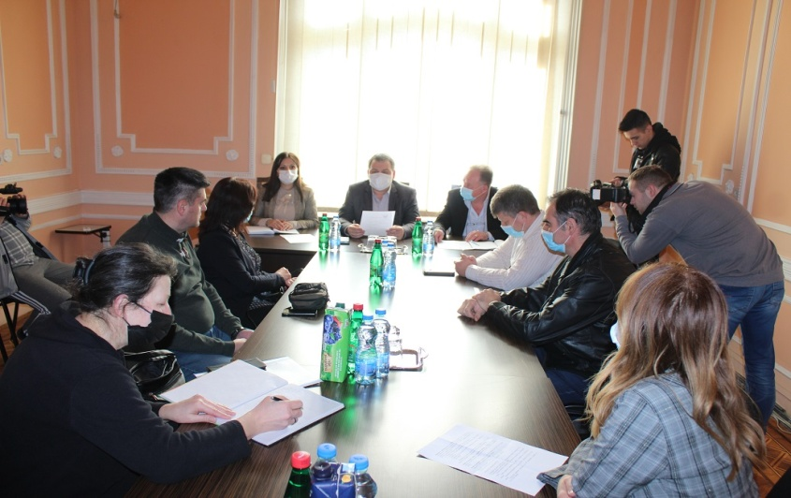
Analytical capabilities for supporting the local business community
The Municipality of Ruma actively cooperates with business people
Economic council Social economic council
Consultation with the business people -there is a frequently updated poll on the website to find out the opinions of the public and the private sector about various subject matters essential for the local community development.
"Invest in Ruma," a banner on the internet presentation, containing much information including the city presentation, municipal decisions, a strategic plan for sustainable development, local programs, investors guide, and companies' register.

Slide 9

The Economic council of the Municipality of Ruma
The Economic Council – Established in 2015, representing a link between the local self-government and the private sector to analyze and enhance the economic situation. The collaboration of the local self-government and business is encouraged to solve the vital public and economic issues jointly.
The Economic Council consists of 16 members-businessmen who meet once in 3 months, work and decide collectively. A new convocation of the Economic Council representatives has been appointed on January 31, 2022.

Slide 10
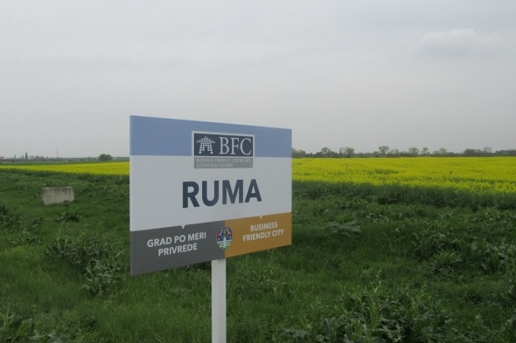
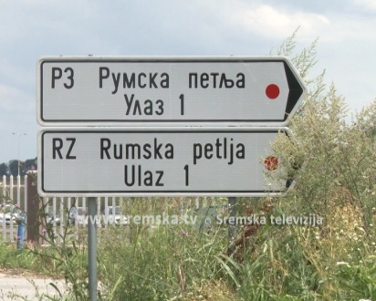
Why investing in the municipality of Ruma
1
FIVE MAIN REASONS FOR INVESTING
2
Cost-effective:
- A qualified workforce, building charges, and land costs at competitive pricing;
Great Geostrategic position:
- Vicinity of the capitol, international airport, highways, and railways;
Great geostrategic position
- Direct access to E70 & E75 highways
A municipality with a clear vision
- Strategic plan for 2014-2020
4
3
Promptly issuing of building permits;
Attractive business locations – direct access to the E-70 highway and five industry zones;
5
Special incentives for investors.

Slide 11
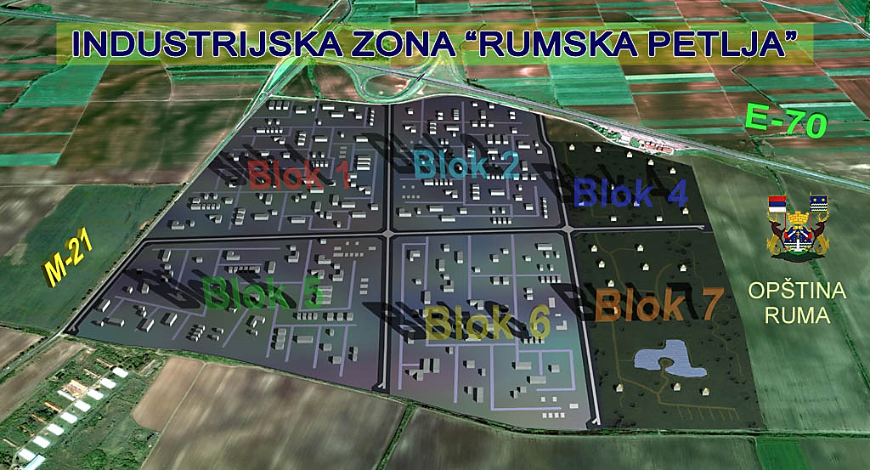












Cooperation with domestic and foreign investors
The Municipality of Ruma has an excellent strategic position and full-infrastructure industrial zones – the most significant is the traffic loop "Rumska petlja." Aside from the traffic loop, there are several industrial zones:
Rumska petlja - West, South 2, West, East... So far, the vast amount of investments has been completed.

Slide 12


Participative budgeting
The Municipality of Ruma has been carrying out the Participative budgeting project eight years in a row, engaging citizens in the budgeting process.
Citizens have an opportunity to be involved in the funds' allocation decision-making process by giving project ideas,and after that voting for the best project that will be included in the following year budget decision.

Slide 13
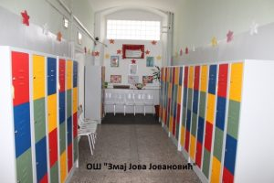
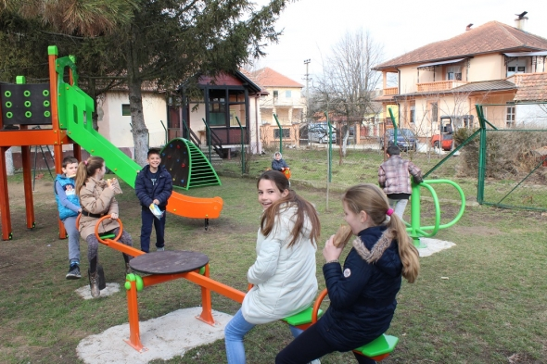
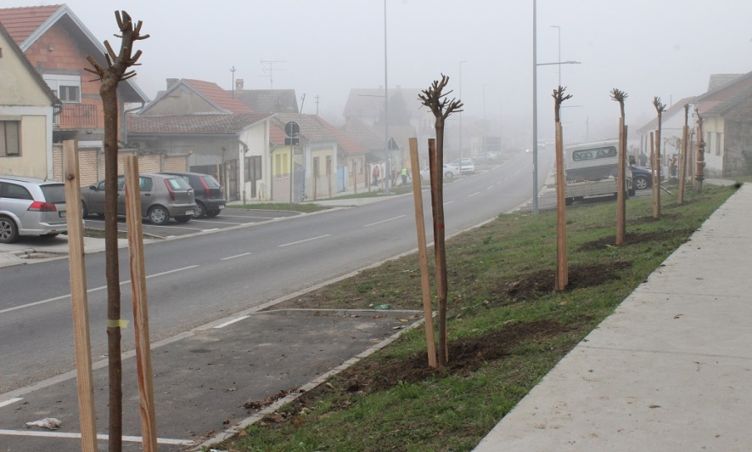
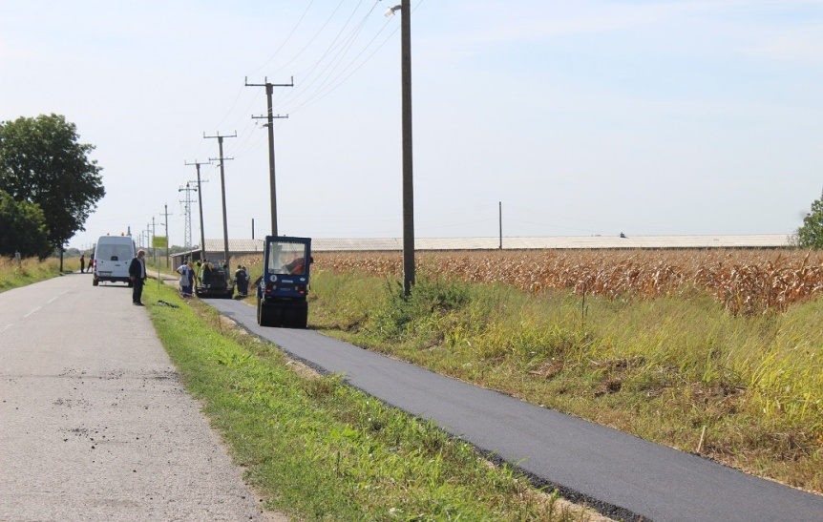
Completed projects within the PB
Three elementary schools, Ivo Lola Ribar, Dusan Jerkovic, Zmaj Jova Jovanovic, and their regional classes
got the student lockers at the end of December 2018. The colorful lockers with over 1,650 partitions are
evenly distributed. This project somehow solves “the heavy school bag problem”
An elevator for disabled was purchased Health Center at Ruma to enable easier access to upstairs medical
services and faster and safer healthcare
New children's playgrounds were built in the villages Donji Petrovci, Nikinci, Klenak, Budjanovci and Mali
Radinci
The construction of skate park (skating, BMX driving, roller skating) and fitness center at the playground in Lenjinova Street in Ruma

Slide 14
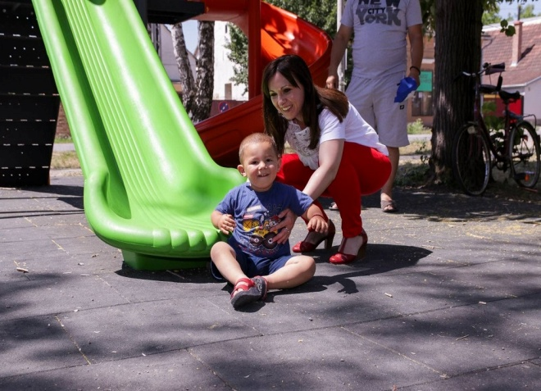
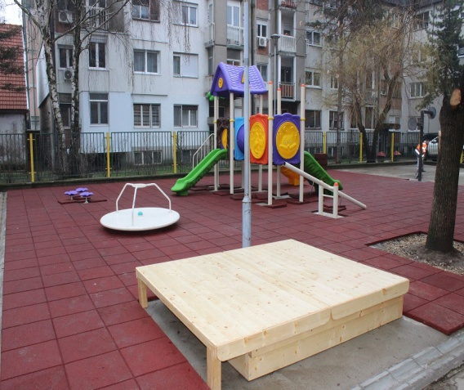
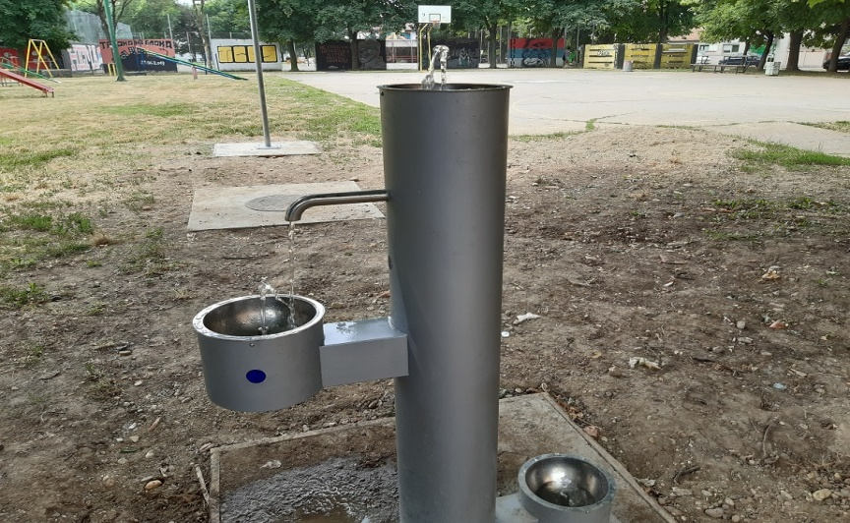
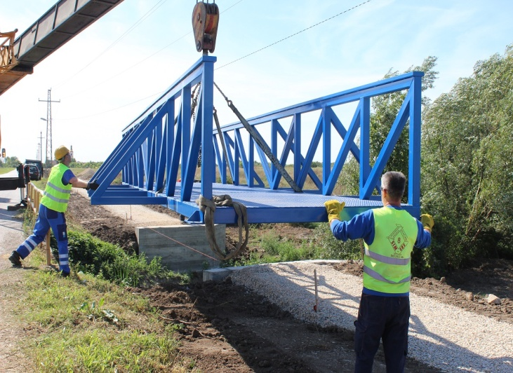
Completed projects within the PB
New children's playgrounds in Ruma in the streets: Zeleznicka, Kosovska and Lenjinova, Detelina and Igraliste and in a small park
Students lockers in all schools on the territory of Ruma municipality
Arranging the yard of the kindergarten the "Centar" facility and equipping it with furniture
Smart boards in schools (4 urban and 11 rural primary schools)
The construction of the pedestrian-bicycle path Donji Petrovci-Putinci is in progress
Sensor fountains at six locations in the city
The first inclusive playground at the kindergarten facility ,,Livade” for preschool education and education of children
New childrens playgrounds in villages : Kraljevci, Dobrinci, Putinci, Zarkovci and Hrtkovci.

Slide 15
Development Plan of the Municipality of Ruma 2021-2030.
The LER department is engaged in making strategies and action plans as well as in their monitoring and implementation.
Development Plan of the Municipality of Ruma 2021-2030. defines the following strategic goals:
  Economic development
  Social conditions and perspectives
  Environment and resource conservation
The Development Plan of the Municipality of Ruma is the basis for the adoption of all other planning documents and one such document has a clear picture of the aspirations of local governments to continuously improve the lives of every resident of the municipality.
Development Plan of the Municipality of Ruma 2021-2030
  Economic development
  Social conditions and perspectives
  Environment and resource conservation

Slide 16
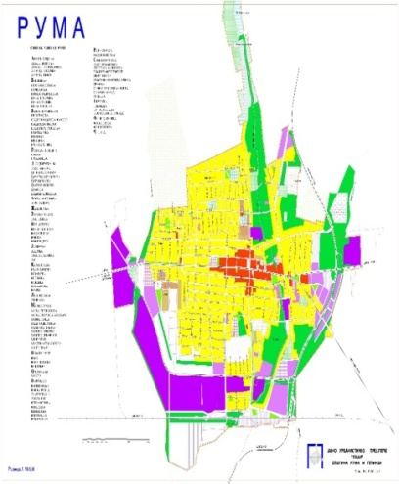
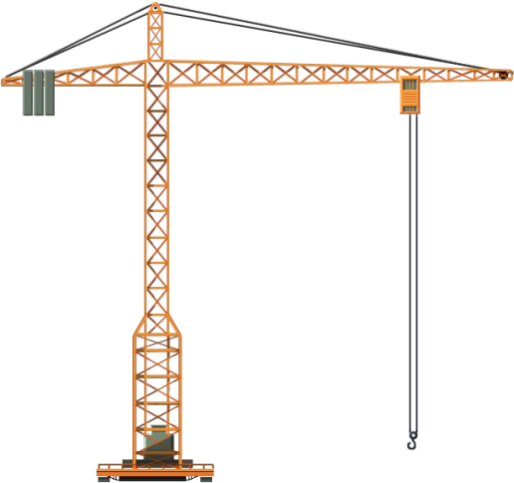
Creating strategies and local action plans
In addition to the mentioned strategy, there are as well the following ones.
The Strategy of rural development of the Municipality of Ruma 2017/21.
The Strategy of social politics of the Municipality of Ruma 2017/22.
The Plan of the capital investment of the Municipality of Ruma 2018/22.
The mid-term program for the construction land reorganization 2016/21.
Besides, the Municipality of Ruma has adopted the following.
The Local action plan for the waste management the Municipality of Ruma 2010-2019.
The Local action Plan for addressing the issue of refugees, internally displaced persons, and returnees under the readmission agreement in the Municipality of Ruma from 2014-2018.
The action plan for the Youth the Municipality of Ruma 2014-2019.
The Local Action Plan for improving the Position of Roma Minority in the Municipality of Ruma 2015-2020.
The Action Plan Amendments for the Improvement of the Position of Roma Minority in the Municipality of Ruma 2017-2020., Local Action Plan for social inclusion of Roma men and women in the Municipality of Ruma,for the period 2021-2022.

Slide 17
Maintaining database
Entrepreneur and business (LTD) database
Domestic investors database
Foreign investors database
Investment locations database (greenfield and brownfield locations)
Projects database

Slide 18

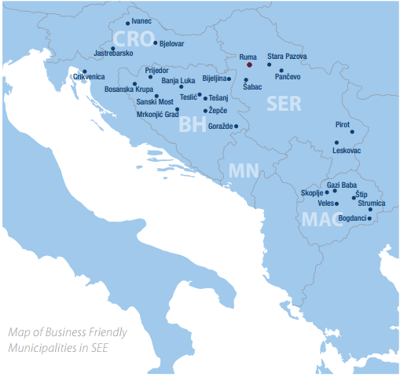
The favorable business environment international certificate
The certificate testifies that the Municipality of Ruma is successful, enabling its investors quality cooperation, transparent decision-making and new strategic-development plans, as well as a commitment to the Municipal dynamic development. The Municipality of Ruma has been four times awarded the certificate so far, the first time it was in 2011. As a result, the municipality has experienced an increase in new investments and the growing investment-interest in the municipality. After the Verification check Year 2021., the Municipality of Ruma achieved 91.00% and justified and fulfilled the conditions for obtaining the regional BFC SEE (Business Friendly Certification South Europe) certificate, which once again confirmed the status of local self-government with a favorable business environment in Southeast Europe according to the last III edition of the international BFC SEE standard.
This is just one of the many awards and recognitions for the Municipality of Ruma. For instance, the municipality has been recognized as the Vojvodina investment leader – alongside Novi Sad and Sombor – by the Provincial government.

Slide 19

Department for local economic development of the Municipality of Ruma
THANK YOU FOR YOUR
ATTENTION
The Municipality of Ruma
Glavna 155, Ruma
Department for local economic development
ruma.razvoj@gmail.com
www.ruma.rs

